Slide 1

Modern Control Theory
Lecture No. 18
Obtaining the Kalman Filter Eqns. From the Posterior Eqn. --- Substituting Prior, Likelihood & Evidence in the RHS

Slide 2







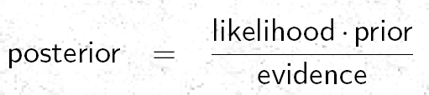
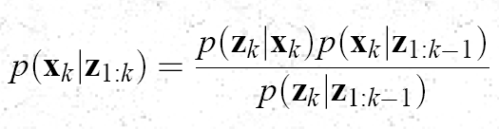

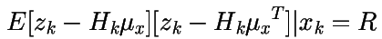


The “Posterior” Function
The Prior Function
Update
Prediction
(k-1)+
(k)-
(k)+
k-1
To Show that Each
Term is
Gaussian
k
z(k-1)
z(k)
The Likelihood Function
To Obtain the Mean & Covariance

Slide 3






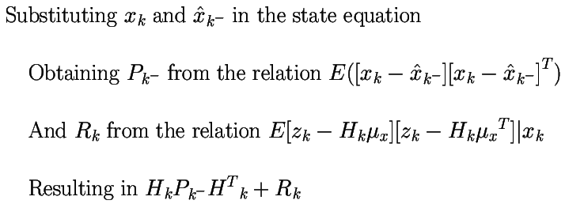
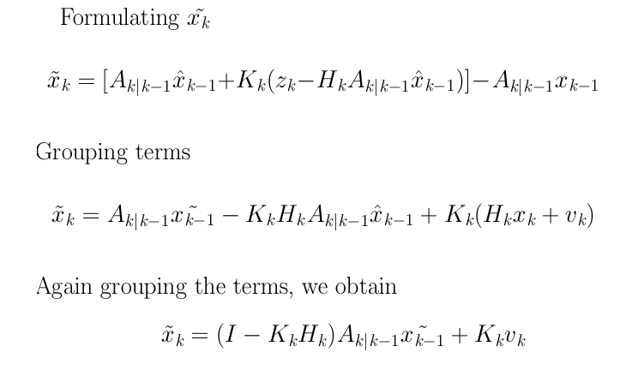




Mean & Covariance of Evidence Term

Slide 4




Substituting expressions for
PDF on the RHS
Likelihood
Prior
Evidence
Let us plug in the
Prior, Likelihood &
Evidence Terms, on
the RHS, to
Obtain
PDF for Posterior

Slide 5
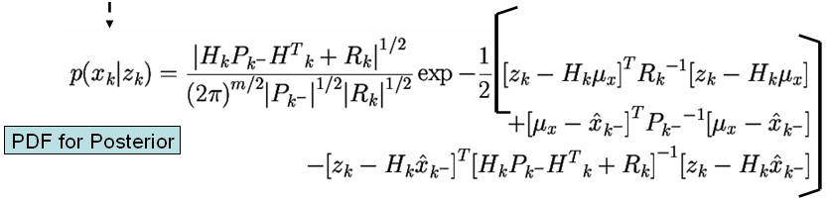
PDF for the Posterior
To Cast the Expression for Posterior PDF in a Gaussian Form
The Three Separate Determinant Terms, would have to be Equivalent to a Single Determinant Square Root in the Denominator
Sum of the Three Quadratics in the Exponential would have to be made Equivalent to a Single Quadratic Form
To achieve the desired results we have to make use of the “Matrix Inversion Lemma”

Slide 6
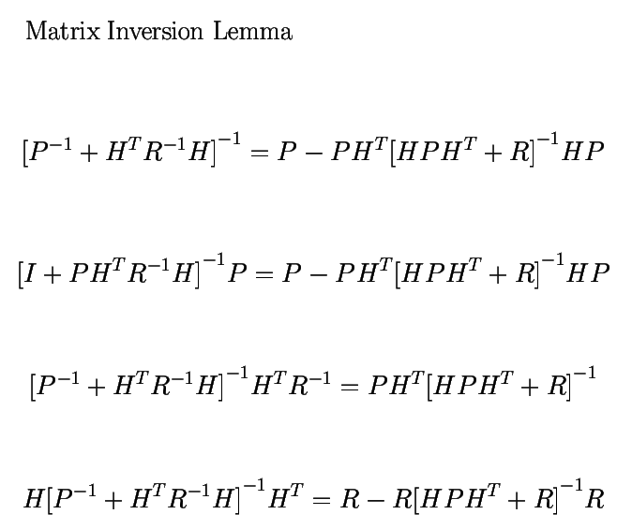
Working on m x m inversions
Valid for Positive Definite P & R
m x m
Matrix Inversion
n x n
Matrix Inversion

Slide 7
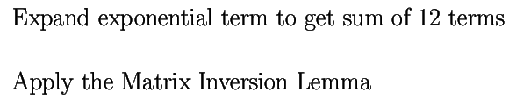





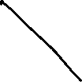
To Reduce the Posterior
PDF to a Single
Quadratic Form

Slide 8



Further Application of the
Matrix Inversion Lemma
Casting in the earlier
Condn. Mean Eqn.
We obtain more
efficient expressions
for State & Covariance
Using a term called
the Kalman Gain
Kalman Filter Update
Equations ?
The expressions for
Condn. Mean &
Covariance becomes

Slide 9




Slide 10
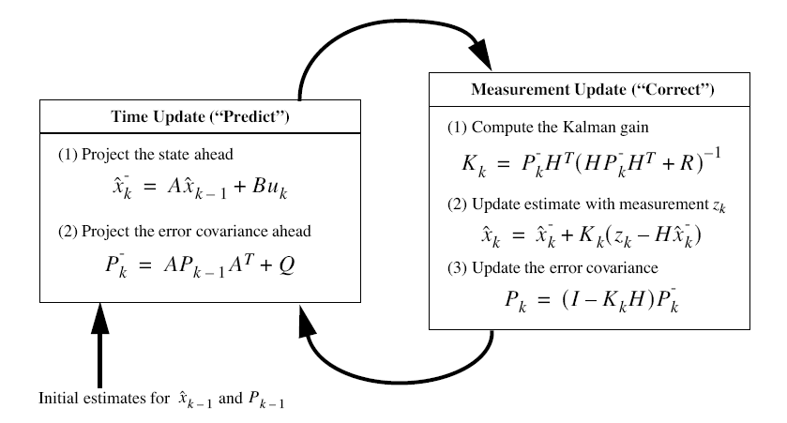
The Kalman Filter

